Slide 1
K-MER COUNTING
APP
Team
Nadeen Amr Ataa El-Gendy
Rawan Ahmed Ezat El-Sherbiny
Amira Ebrahim MohamedAbdelatif
Manar Gehad EL-awady Grawish
Noran Emad Mohamed EL-Nemr

Slide 2
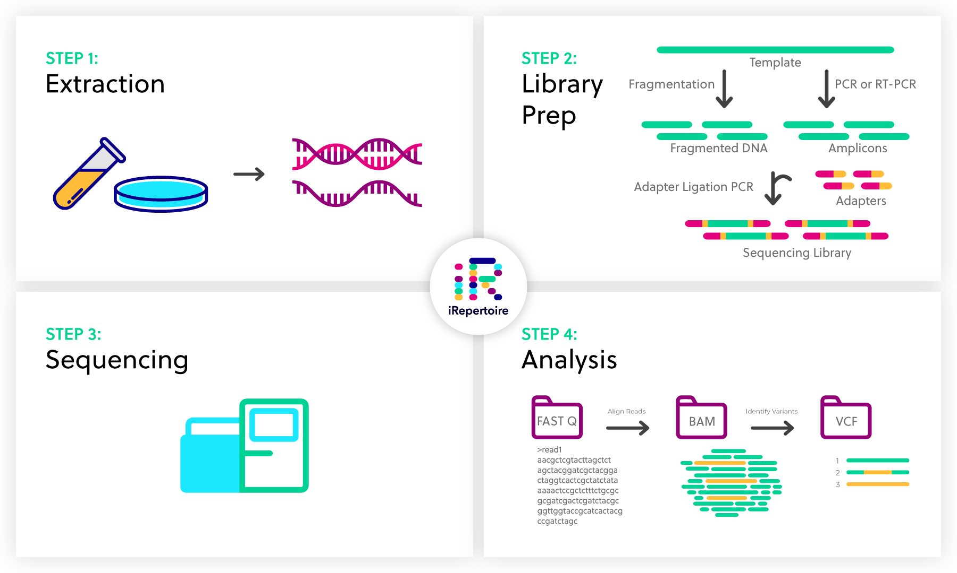
Sequencing pipeline
for a typical DNA sequencing strategy involves aligning the raw reads
from FASTQ,FASTA files against the human reference genome.

Slide 3
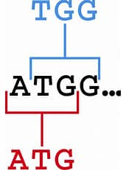
What is k-mer?
Definition
Advantage

Slide 4

The problems
Count k-mer.
Fast processing.

Slide 5
The solution
We decide to make Desktop k-mer counting(python GUI)
that allow us to:

Slide 6
Choose k-mer length and extract it from genome .
Report num of
k-mers , kemer and index.
Make fast processing.
Extract and approximate
k-mer count.

Slide 7

COMPETITORS AND DIFFERENCES
we will make the tool as a desktop application .
we will take care about the required time for the process.
Let user enter any k-mer-length,result is kemer count,kemer and indexes

Slide 8
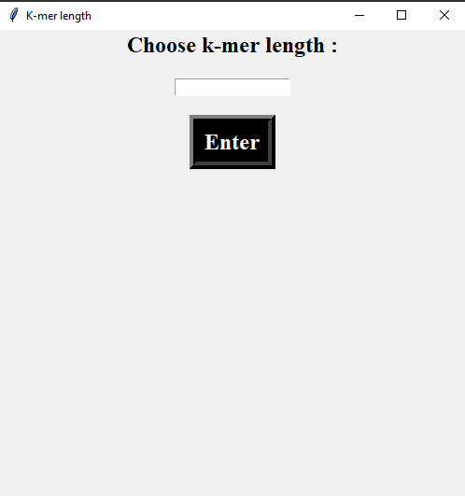
Proto type

